Slide 1
Folded Cascode Stage
Small Signal models for building blocks
Jan Genoe
February 2022

Slide 2
# Folded cascode stage

Slide 3
###### Overzicht

Slide 4
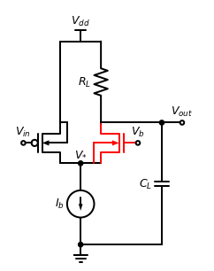

Slide 5
###### Practical folded cascode amplifier stage configuration

Slide 6
###### Circuit block under consideration for measuring the folded cascode output impedance

